Slide 1


Support Abandoned & Stray Animal using Analytics
ACTIONABLE INSIGHTS FOR ANIMAL SHELTERS
David Ku

Slide 2
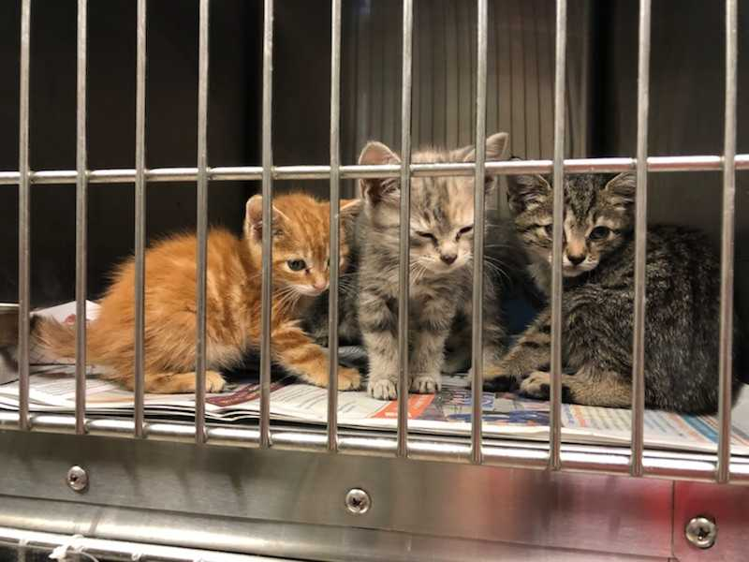
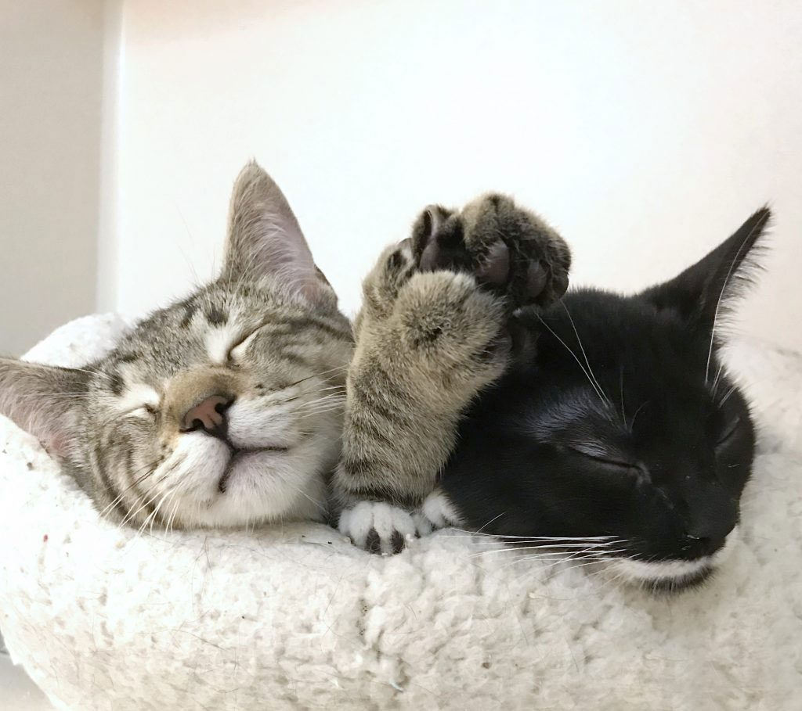
Deworming, breed, and the number of photos are the top three factors that can impact the outcome of adoption

Slide 3




AGENDA
1
PROJECT & DATA DESCRIPTION
2
DATA EXPLORATION
Dashboard
3
MODELING
Inference & Prediction
CONCLUSION
Actionable Insights
4

Slide 4
1
PROJECT & DATA DESCRIPTION
2
DATA EXPLORATION
Dashboard
3
MODELING
Inference & Prediction
CONCLUSION
Actionable Insights
4

Slide 5
PROJECT DESCRIPTION
Explore and analyze roughly 10,000 animal adoption records from animal shelters in Malaysia with the goal to discover the key drivers that can influence the likelihood of adoption
DESCRIPTION
EXPLORATION
MODELING
CONCLUSION

Slide 6
DATA DESCRIPTION
Data Source: https://www.kaggle.com/c/petfinder-adoption-prediction/data
Target Variables: Adoption Speed
Same day as it was listed
Within 1 week after being listed
Within 30 days after being listed
Within 90 days after being listed
No adoption after 100 days of being listed
Explanatory Variables:
Breed, Health Condition, Number of Photos, etc
Adopted
Not Adopted
DESCRIPTION
EXPLORATION
MODELING
CONCLUSION

Slide 7
1
PROJECT & DATA DESCRIPTION
2
DATA EXPLORATION
Dashboard
3
MODELING
Inference & Prediction
CONCLUSION
Actionable Insights
4

Slide 8
INSIGHTS from DASHBOARD
Vaccination doesn’t increase the likelihood of adoption
Sterilization has negative impact on the likelihood of adoption
Female cats seem to have higher chance being adopted
Kitten seem more likely to be adopted
Number of Photos seems having a positive effect on adoption
Pedigreed cats seem to have higher chance being adopted
DESCRIPTION
EXPLORATION
MODELING
CONCLUSION

Slide 9
1
PROJECT & DATA DESCRIPTION
2
DATA EXPLORATION
Dashboard
3
MODELING
Inference & Prediction
CONCLUSION
Actionable Insights
4

Slide 10
DATA QUALITY VALIDATION
How to check if the data is ready for modeling?
Feature Engineering
Multicollinearity
Standardization
Categorical Variable Encoding
DESCRIPTION
EXPLORATION
MODELING
CONCLUSION

Slide 11
FEATURE ENGINEERING
Pedigreed Breeds:
According to Cat Fanciers’ Association(CFA), there are 45 pedigreed breeds recognized
Pedigreed breed cats are rare which might cause the problem of quasi separation
Original Breeds |  | CFA Certified
45 Pedigreed Breeds |  | CFA Certified Breed
Other Breeds |  | Non-Pedigreed Breeds
DESCRIPTION
EXPLORATION
MODELING
CONCLUSION

Slide 12
MULTICOLLINEARITY & STANDARDIZATION
Four continuous variables: Age, Fee, Number of Videos, Number of Photos
Variables | VIF
Age | 1.16
Fee | 1.07
Video Amount | 1.07
Photo Amount | 1.26
DESCRIPTION
EXPLORATION
MODELING
CONCLUSION

Slide 13
REFERENCE CODING
Encode the 9 categorical variables in the data using reference coding
Health Condition
 | x1 | x2
Healthy | 1 | 0
Minor Injury | 0 | 1
Serious Injury | 0 | 0
DESCRIPTION
EXPLORATION
MODELING
CONCLUSION

Slide 14
MODELING
How to verify the insights we found previously in the dashboard?
Inference: Logistic Regression
Prediction: Random Forest
DESCRIPTION
EXPLORATION
MODELING
CONCLUSION

Slide 15
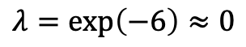
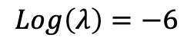
LOGISTIC REGRESSION
Regularized Logistic Regression (LASSO): variable selection based on AUC
Adopted ~ Gender + Maturity Size + Fur Length + Vaccinated + Dewormed + Sterilized + Health + CFA Certified + Color + Age + Fee + Number of Videos + Number of Photos
$$Log\left(λ\right)=−6$$
$$λ=\exp\left(−6\right)≈0$$
DESCRIPTION
EXPLORATION
MODELING
CONCLUSION

Slide 16
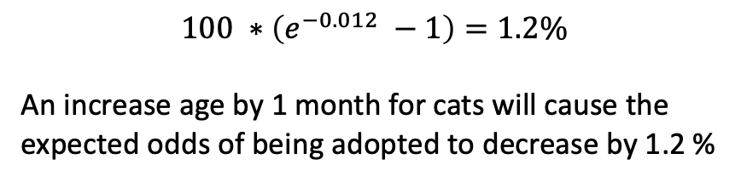
LOGISTIC REGRESSION
Significant variables based on a regular logistic regression:
 | Variables | P-Value | Coefficient Estimates
Continuous | Age | < 0.001 | -0.0120
 | Number of Photos | < 0.001 | 0.1024
 | Fee | < 0.001 | -0.0029
Categorical | CFA Certified | 0.031 | 0.3657 (Pedigreed)
 | Sterilization | < 0.001 | 0.9240 (Not Neutered)
 | Dewormed | 0.001 | -0.2772 (Not Dewormed)
$$100 ∗\left(e^{−0.012} −1\right)=1.2\%$$
An increase age by 1 month for cats will cause the
expected odds of being adopted to decrease by 1.2 %
DESCRIPTION
EXPLORATION
MODELING
CONCLUSION

Slide 17
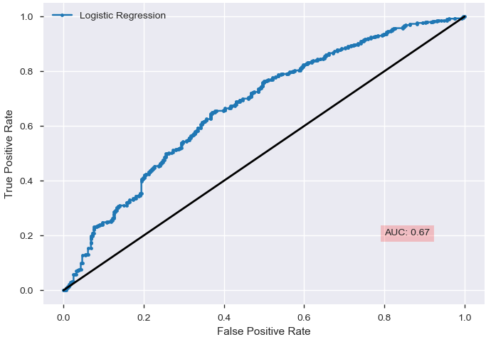
LOGISTIC REGRESSION
Power on Prediction: Testing Accuracy (AUC)
DESCRIPTION
EXPLORATION
MODELING
CONCLUSION

Slide 18
RANDOM FOREST
Initial Model
Model Parameters:
Number of Trees: 250
Criterion: Gini
Bootstrap: True
Max_features (number of features to consider at every split): auto
Max_depth (maximum number of levels in tree): None
Min_samples_split (minimum number of samples required to split a node): 2
Min_samples_leaf (minimum number of samples required at each leaf node): 1
DESCRIPTION
EXPLORATION
MODELING
CONCLUSION

Slide 19
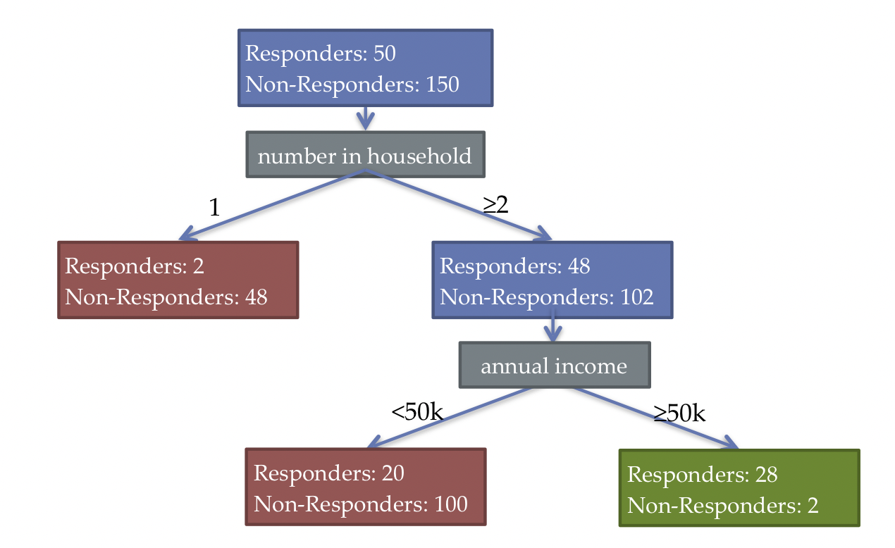
DECISION TREE
DESCRIPTION
EXPLORATION
MODELING
CONCLUSION

Slide 20
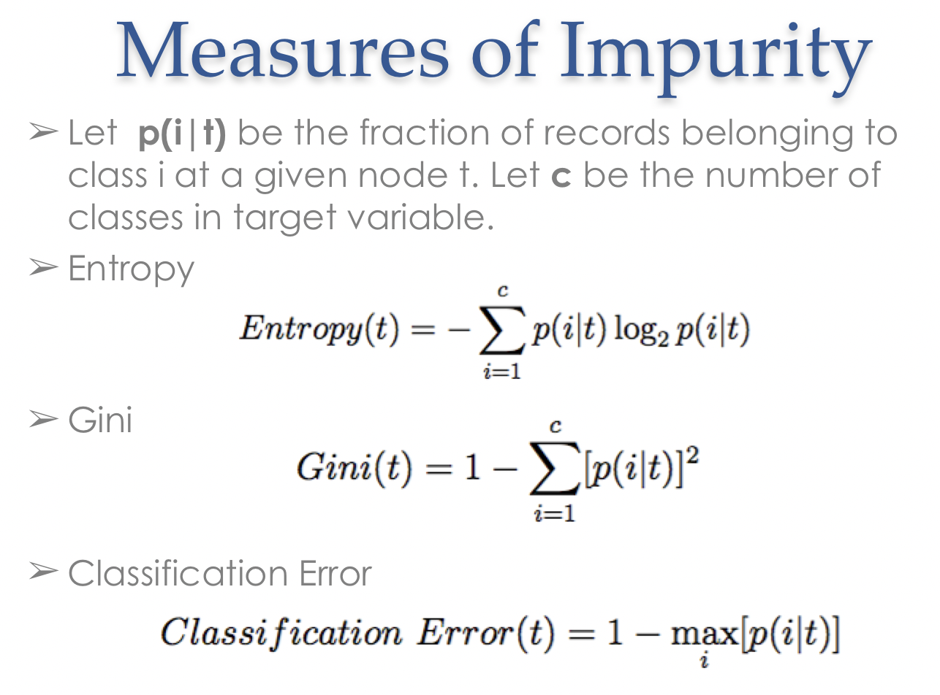
DECISION TREE
DESCRIPTION
EXPLORATION
MODELING
CONCLUSION

Slide 21
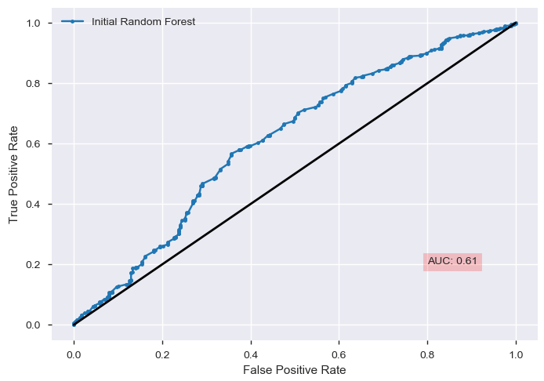
RANDOM FOREST
Initial Model Performance on Testing Data
DESCRIPTION
EXPLORATION
MODELING
CONCLUSION

Slide 22
RANDOM FOREST
Random Forest Hyperparameter Tuning by Randomized Search CV
Model Parameters:
Number of Trees: 200, 400, 600, 800, 1000, 1200, 1400, 1600, 1800, 2000
Bootstrap: True, False
Max_features (number of features to consider at every split): auto, sqrt
Max_depth (maximum number of levels in tree): 10, 20, 30, 40, 50, 60, 70, 80, 90, 100, 110, None
Min_samples_split (minimum number of samples required to split a node): 2, 5, 10
Min_samples_leaf (minimum number of samples required at each leaf node): 1, 2, 4
Hyperparameters:
Number of Trees: 2000
Bootstrap: False
Max_features: auto
Max_depth: 10
Min_samples_split: 2
Min_samples_leaf: 2
DESCRIPTION
EXPLORATION
MODELING
CONCLUSION

Slide 23
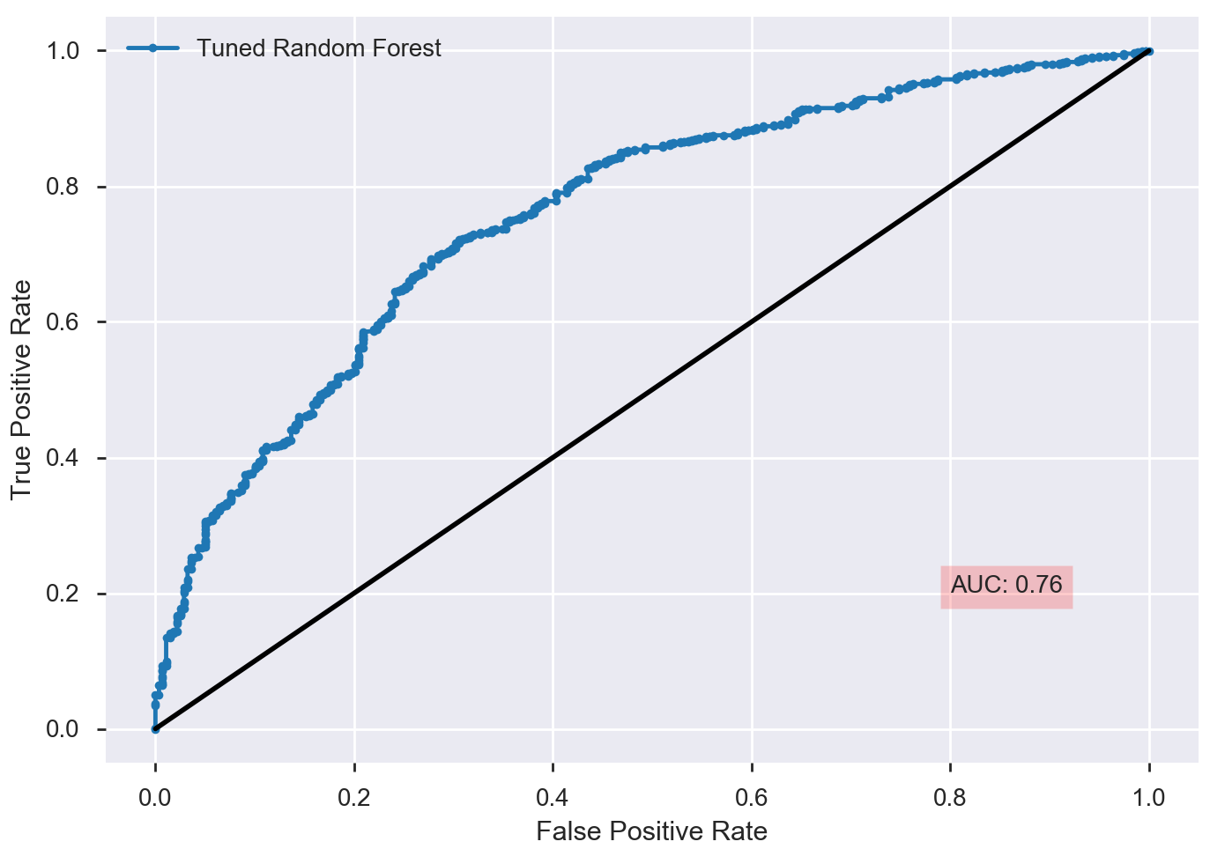
RANDOM FOREST
Tuned Model Performance on Testing Data
DESCRIPTION
EXPLORATION
MODELING
CONCLUSION

Slide 24
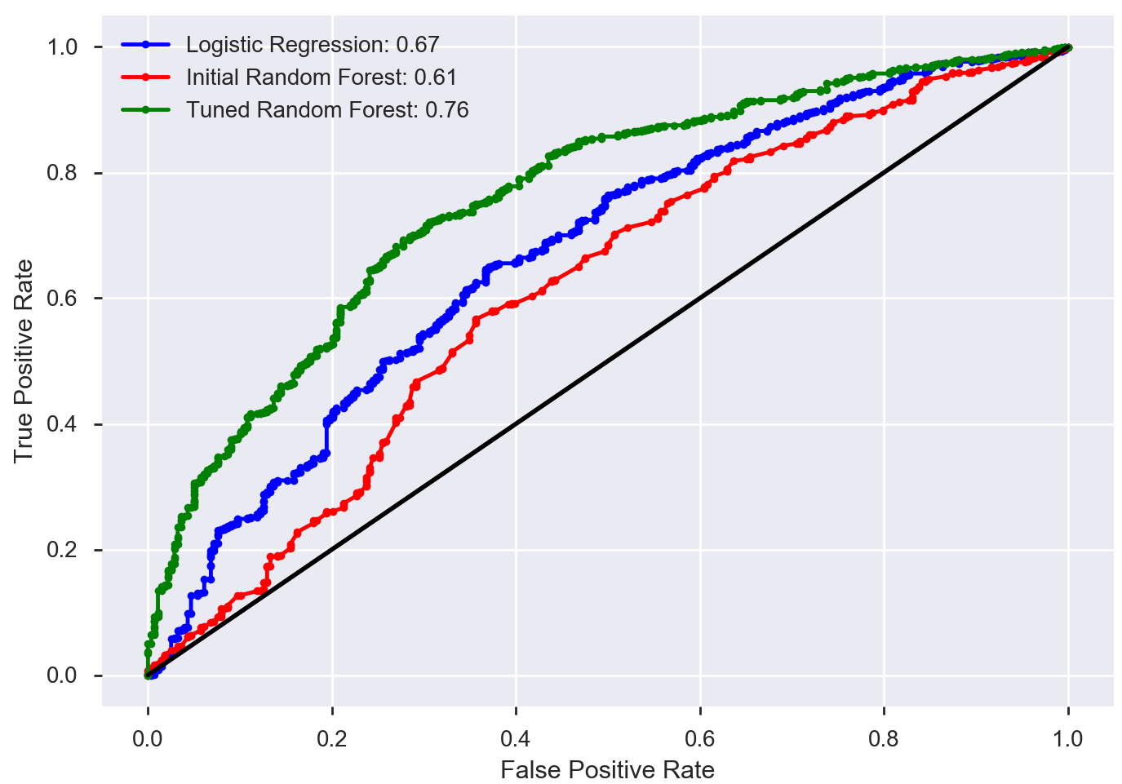
MODEL COMPARISON
Model Performance Comparison
DESCRIPTION
EXPLORATION
MODELING
CONCLUSION

Slide 25
RANDOM FOREST
Variable Importance of Top Six Variables Based on the Tuned Model
Variables | Importance
Age | 0.317
Number of Photos | 0.195
Sterilization | 0.102
Fee | 0.070
CFA certified | 0.041
Vaccination | 0.031
DESCRIPTION
EXPLORATION
MODELING
CONCLUSION

Slide 26
MODEL COMPARISON
Variable Importance Comparison
Logistic Regression
 | Variables | P-Value | Coefficient Estimates
Continuous | Age | < 0.001 | -0.0120
 | Number of Photos | < 0.001 | 0.1024
 | Fee | < 0.001 | -0.0029
Categorical | CFA Certified | 0.031 | 0.3657 (Pedigreed)
 | Sterilization | < 0.001 | 0.9240 (Not Neutered)
 | Dewormed | 0.001 | -0.2772 (Not Dewormed)
Random Forest
Variables | Importance
Age | 0.317
Number of Photos | 0.195
Sterilization | 0.102
Fee | 0.070
CFA certified | 0.041
Vaccination | 0.031
DESCRIPTION
EXPLORATION
MODELING
CONCLUSION

Slide 27
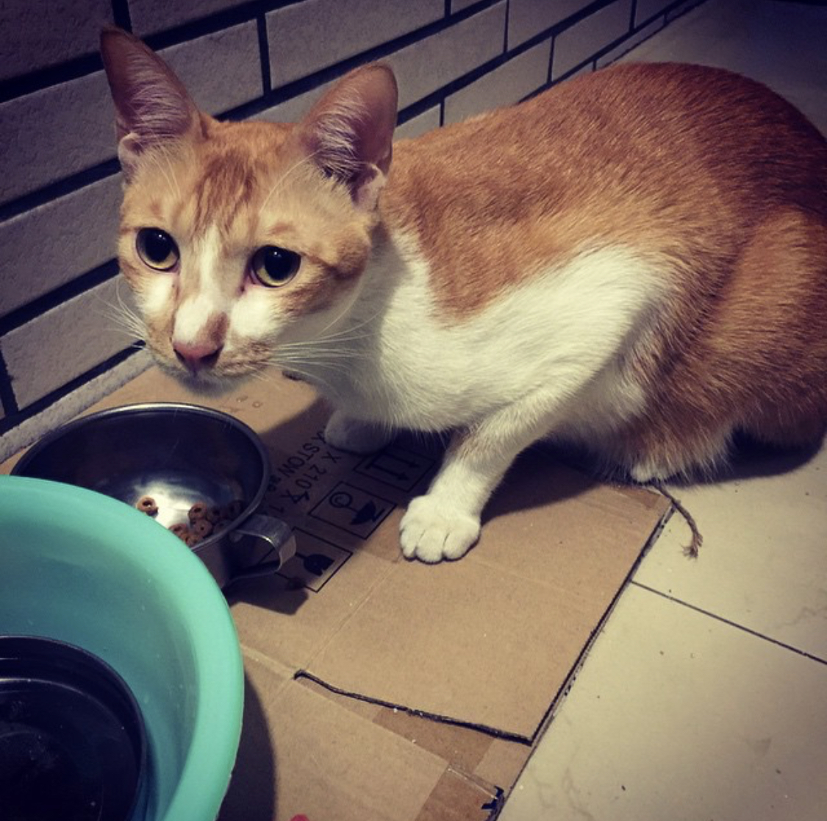
EXAMPLE
How likely Pineapple will be adopted based on the data?
Gender: male
Maturity Size: medium
Fur Length: short
Vaccinated: yes
Dewormed: yes
Sterilized: yes
Health: healthy
Color: orange
CFA certified: non-pedigreed breed
Age: 12 months
Number of Videos: 0
Number of Photos: 1
65% of chance being
adopted
DESCRIPTION
EXPLORATION
MODELING
CONCLUSION

Slide 28
1
PROJECT & DATA DESCRIPTION
2
DATA EXPLORATION
Dashboard
3
MODELING
Inference & Prediction
CONCLUSION
Actionable Insights
4

Slide 29
CONCLUSION
Younger cats are more likely being adopted
Number of photos can increase the chance of being adopted
Sterilization and vaccination might not mean a lots when people consider adopting cats
Sterilization can potentially decrease the chance of being adopted
Vaccination doesn’t affect whether cats will be adopted
Now, what are the actionable insights for animal shelters?
DESCRIPTION
EXPLORATION
MODELING
CONCLUSION

Slide 30
Thank you for listening !

Slide 31


